Slide 1

Photoelectric
Effect

Slide 2
Key Objectives
The photoelectric effect, is explained using the concept of light quanta.
On the atomic level, energy and matter exhibit the characteristics of both waves and particles. Young’s double slit experiment is explained with a wave model but produces the same interference and diffraction patterns when one photon at a time or one electron at a time are passed through the slits

Slide 3
Key Objectives
Atomic phenomena and the interaction of light with matter indicate that states of matter and energy are quantised into discrete values.
On the atomic level, electromagnetic radiation is emitted or absorbed in discrete packets called photons. The energy of a photon is proportional to its frequency and constant of proportionality is Planck’s Constant.
Blackbody radiation can be explained using the concept of light quanta.
Planck’s constant, can be determined experimentally using the photoelectric effect and the threshold voltage of coloured LEDs.

Slide 4

Relevant Equations
$$E=hf=\frac{hc}{λ}$$
$$E_{k}=hf−W$$

Slide 5
Text References
STAWA
  Set 12.1
  Set 12.2

Slide 6
Classical physics modelled light as a transverse wave, and this model successfully explains interference, diffraction, refraction, reflection and polarisation.
The ultraviolet catastrophe in blackbody radiation and the photoelectric effect suggested that this model was incomplete.
In the 1800’s physicists were trying to model atomic vibrations, but they kept getting it wrong. This was because they assumed that atomic vibrations were continuous (that they could vibrate at any frequency). Enter Max Planck…

Slide 7
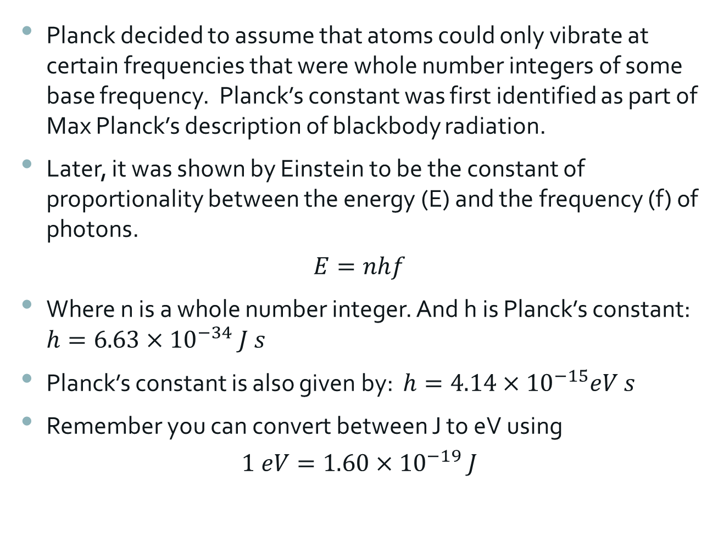
Planck’s constant
Planck decided to assume that atoms could only vibrate at certain frequencies that were whole number integers of some base frequency. Planck’s constant was first identified as part of Max Planck’s description of blackbody radiation.
Later, it was shown by Einstein to be the constant of proportionality between the energy (E) and the frequency (f) of photons.
$$E=nhf$$
Where n is a whole number integer. And h is Planck’s constant: $h=6.63×{10}^{−34} J s$
Planck’s constant is also given by: $h=4.14×{10}^{−15}eV s$
Remember you can convert between J to eV using
$$1 eV=1.60×{10}^{−19} J$$

Slide 8
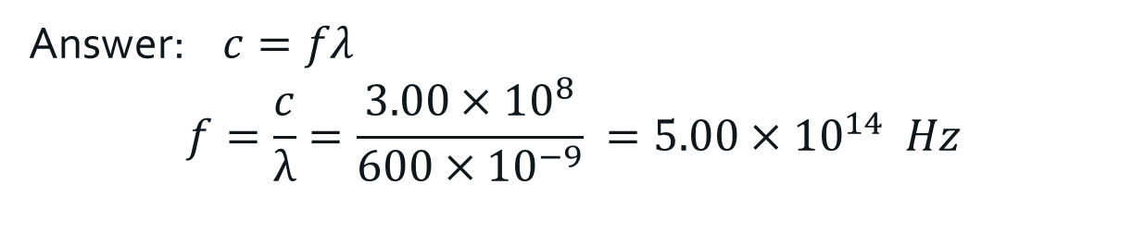
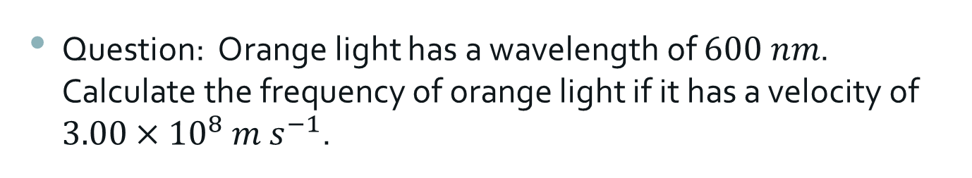
Question: Orange light has a wavelength of $600 nm$. Calculate the frequency of orange light if it has a velocity of $3.00×{10}^{8} m s^{−1}$.
Answer: $c=fλ$
$$f=\frac{c}{λ}=\frac{3.00×{10}^{8}}{600×{10}^{−9}} =5.00×{10}^{14} Hz$$
Question: A radio station broadcasts at a frequency of 774 MHz. How much energy would be contained in a quantum (photon) of this radiation?
Answer: $5.13×{10}^{−25} J$

Slide 9
Question: Consider a red bulb of 100 W and a blue bulb of 100 W emitting light of wavelength of 650 nm and 460 nm respectively.
a) Which bulb emits photons of higher energy (provide value for both in eV and then compare)?
b) Which bulb emits more photons/s?
Answer for a):
Now convert this energy into eV
Similarly calculate energy of a blue photon

Slide 10
Answer for b):
Red globe emits more photons/s
But only a fraction of these are in the visible range.

Slide 11
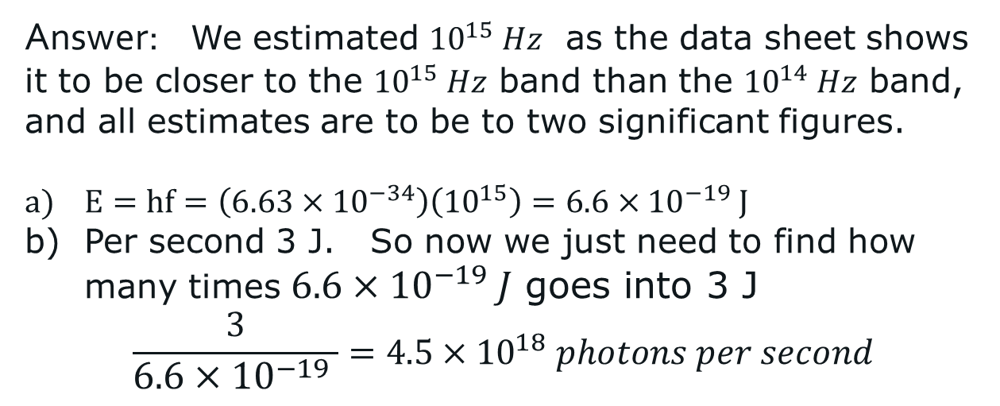
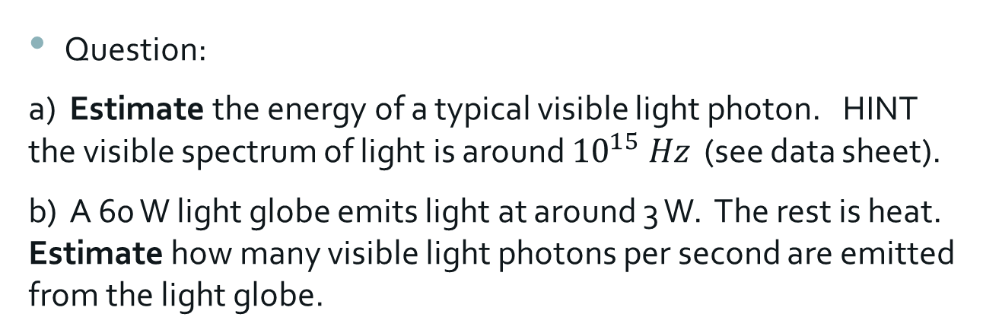
Question:
a) Estimate the energy of a typical visible light photon. HINT the visible spectrum of light is around ${10}^{15} Hz$ (see data sheet).
b) A 60 W light globe emits light at around 3 W. The rest is heat. Estimate how many visible light photons per second are emitted from the light globe.
Answer: We estimated ${10}^{15} Hz$ as the data sheet shows it to be closer to the ${10}^{15} Hz$ band than the ${10}^{14} Hz$ band, and all estimates are to be to two significant figures.
$E=hf=\left(6.63×{10}^{−34}\right)\left({10}^{15}\right)=6.6×{10}^{−19} J$
Per second 3 J. So now we just need to find how many times $6.6×{10}^{−19} J$ goes into 3 J
$$\frac{3}{6.6×{10}^{−19} }=4.5×{10}^{18} photons per second$$

Slide 12
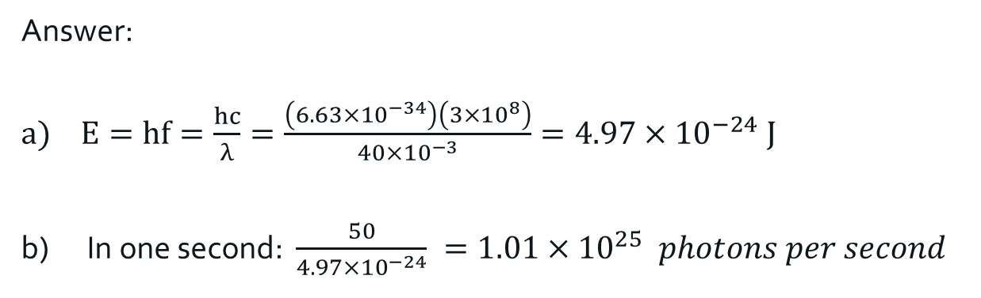
Question: A typical experimental microwave emitter gives radiation of 40 mm wavelengths and emits microwaves at approximately 50 W.
What is the energy of one of the microwave photons?
How many photons are emitted each second?
Answer:
$E=hf=\frac{hc}{λ}=\frac{\left(6.63×{10}^{−34}\right)\left(3×{10}^{8}\right)}{40×{10}^{−3}}=4.97×{10}^{−24} J$
In one second: $\frac{50}{4.97×{10}^{−24}} =1.01×{10}^{25} photons per second$

Slide 13
Photoelectric effect
The photoelectric effect is the emission of electrons or other free charge carriers when a light is shone on a material.
Electrons emitted in this way are called phototelectrons (but there is nothing to differentiate them other electrons, they have the same mass, charge, spin and magnetic moment).
The photoelectric effect was first observed by Hertz in 1887 during experiments with a spark-gap generator (the earliest form of radio receiver).

Slide 14
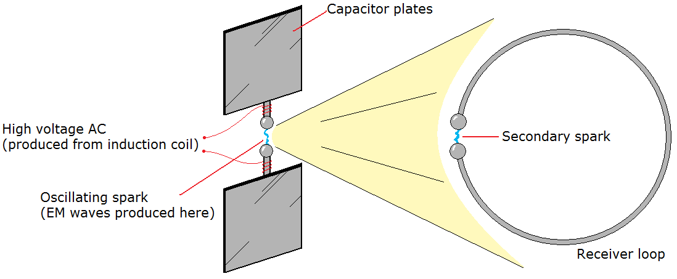
In Hertz’s experiments, a spark is generated between two small metal spheres in the transmitter to induce a similar spark to jump between two metal spheres on the receiver.
Hertz found that he could increase the sensitivity of the his spark-gap generator by illuminating it with visible or ultraviolet light.
Later studies by Thomson showed that the increased sensitivity was the result of the interaction of the light with electrons.

Slide 15
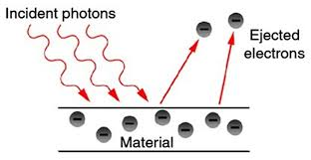
To explain the photoelectric effect modern physics uses a model of light in which it is discrete packets of energy. We call these energy packets photons.

Slide 16
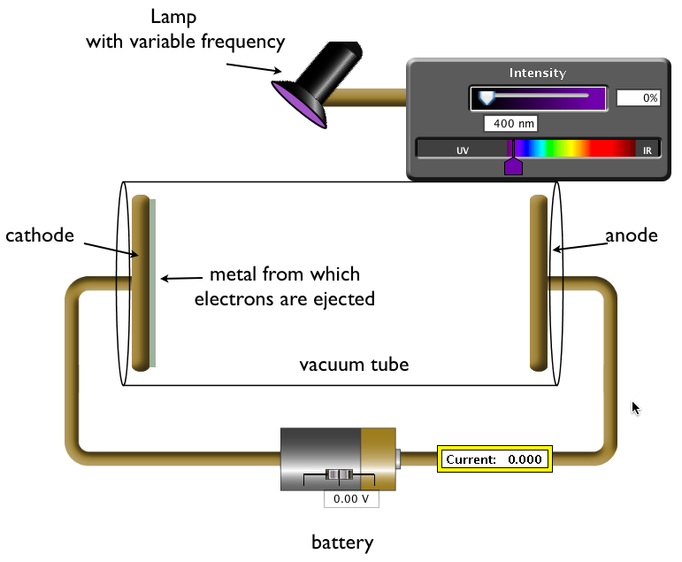
Photoelectric effect experiment
Light from a monochromatic source is beamed onto a photo emissive surface.
When the light hits the surface electrons are released from the surface, leaving the plate with a positive charge.
The electrons move off in all directions and some make it to be absorbed by the collector surface, leaving the plate with a negative charge.
This causes a current to flow.

Slide 17
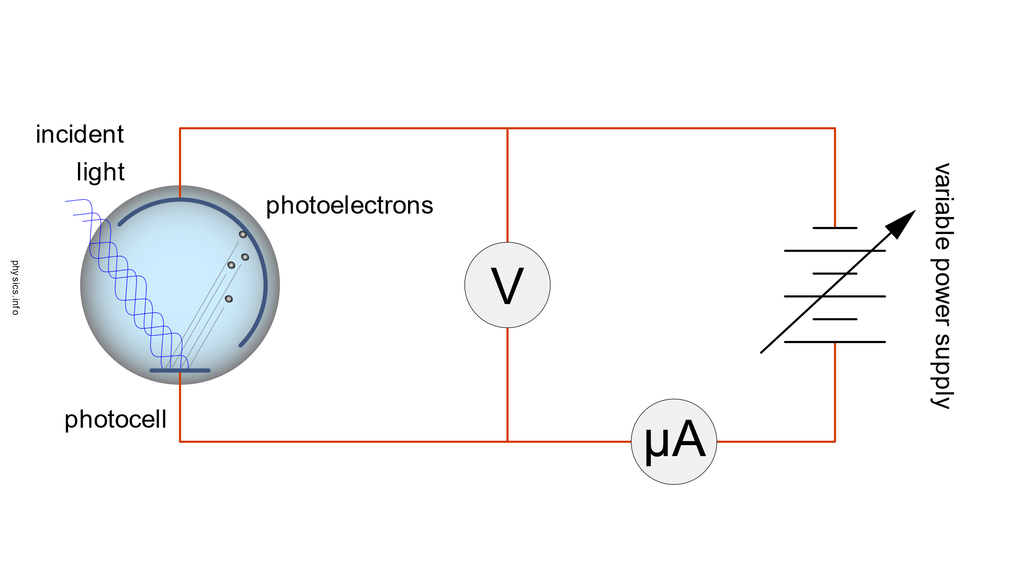
To avoid interference of gas in the transfer of electrons the two plates are usually enclosed in a vacuum tube.

Slide 18
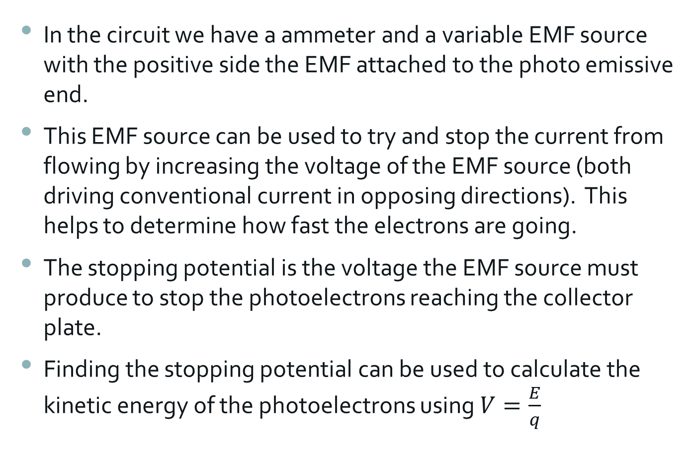
In the circuit we have a ammeter and a variable EMF source with the positive side the EMF attached to the photo emissive end.
This EMF source can be used to try and stop the current from flowing by increasing the voltage of the EMF source (both driving conventional current in opposing directions). This helps to determine how fast the electrons are going.
The stopping potential is the voltage the EMF source must produce to stop the photoelectrons reaching the collector plate.
Finding the stopping potential can be used to calculate the kinetic energy of the photoelectrons using $V=\frac{E}{q}$

Slide 19
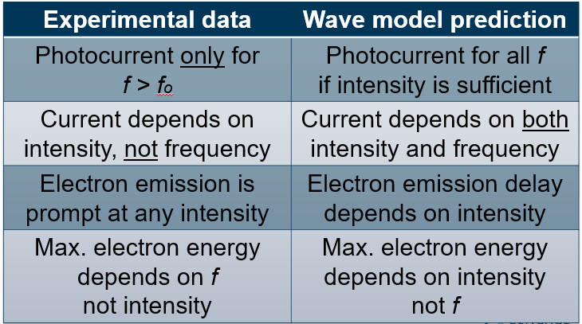
The photoelectric effect does not support the wave model…
Notes:
Data from photoelectric effect experiments challenge predictions based on the electromagnetic model of light. Waves carry energy in their amplitudes, not their frequencies. As long as the intensity is high enough, photoelectrons should be emitted, independently of frequency.
Waves deliver their energy in a regular way based on frequency. The number of photoelectrons emitted should be greater for both intensity and the rate at which energy is delivered (f).
Electron emission will be delayed if the intensity is low because electrons will need some time to absorb enough energy. Maximum energy of photoelectrons will occur because of the energy input, i.e. intensity.
The results suggest this model does not work.

Slide 20
Key points about the photoelectric effect
Electrons are emitted when light shines on metal surfaces.
At all intensities; no electrons are emitted unless the frequency of the light in is greater than a critical frequency.
The number of electrons emitted is proportional to the intensity of the light.
The work function of a metal is the amount of energy it takes for an incident photon to release an electron from the metal.
This means the photon must be a certain frequency (the threshold frequency) or greater in order to cause the metal to emit electrons.
Any photon energy above the amount required to eject a photoelectron is converted into kinetic energy for the photoelectron (so higher frequency means faster moving photoelectron).

Slide 21
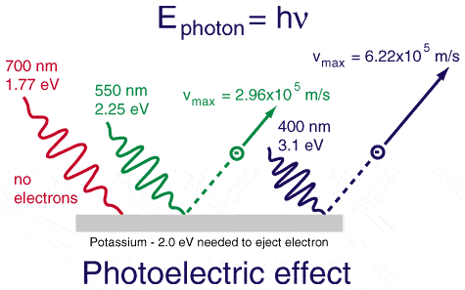
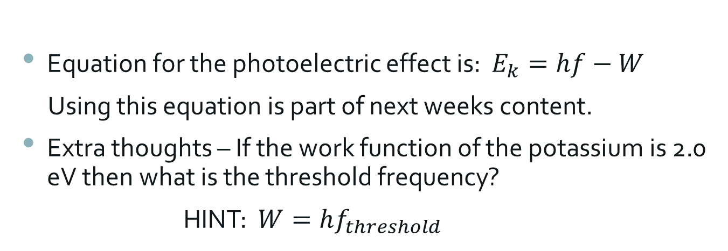
Equation for the photoelectric effect is: $E_{k}=hf−W$
Using this equation is part of next weeks content.
Extra thoughts – If the work function of the potassium is 2.0 eV then what is the threshold frequency?
HINT: $W=hf_{threshold}$

Slide 22
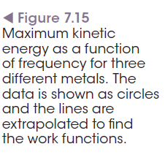
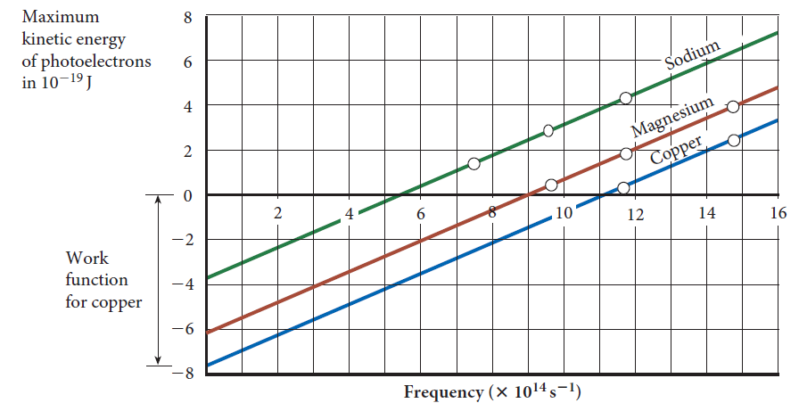
Graphing the photoelectric effect
When creating a graph of the maximum kinetic energy of photo electrons vs the frequency of light then the gradient of the line is Planck’s constant. It can be seen that each metal has a different threshold frequency for photoelectron emission.

Slide 23
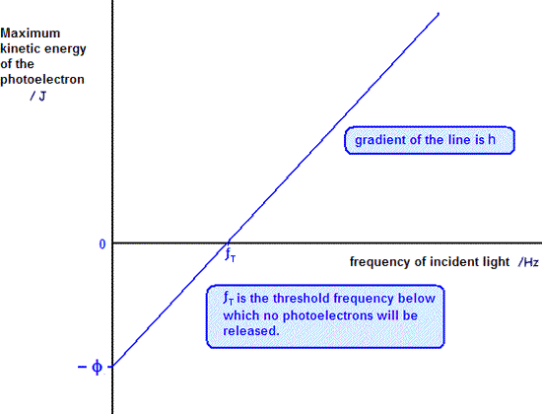
The y intercept is the work function of each metal (but you take an absolute of this value). On a graph that has the y axis in eV the work function can be found in eV.

Slide 24
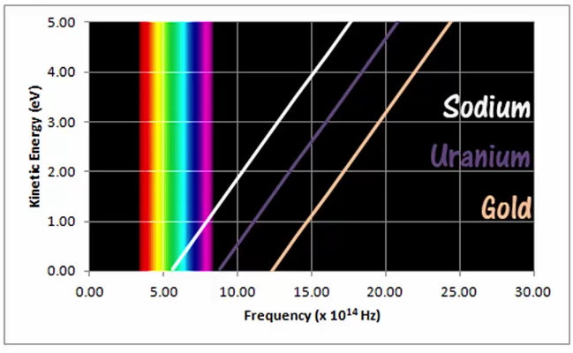
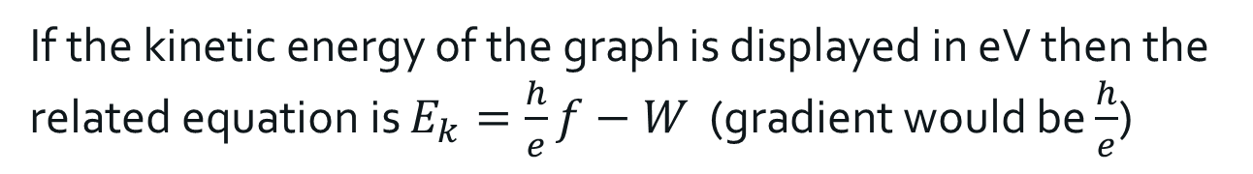
If the kinetic energy of the graph is displayed in eV then the related equation is $E_{k}=\frac{h}{e}f−W$ (gradient would be $\frac{h}{e}$)

Slide 25
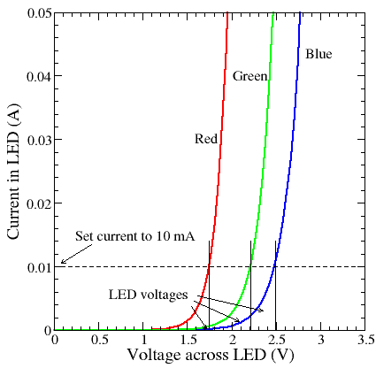
LEDs and Planck's constant
Light-emitting diodes (LEDs) convert electrical energy into light energy.
They emit radiation (photons) of visible wavelengths.
We measure the minimum voltage required to cause current to flow and photons to be emitted.
We can use the threshold voltage to find the energy in joules (using E=eV). And use the known wavelength to find the frequency.
Then we can use E and f to determine Planck’s constant.

Slide 26
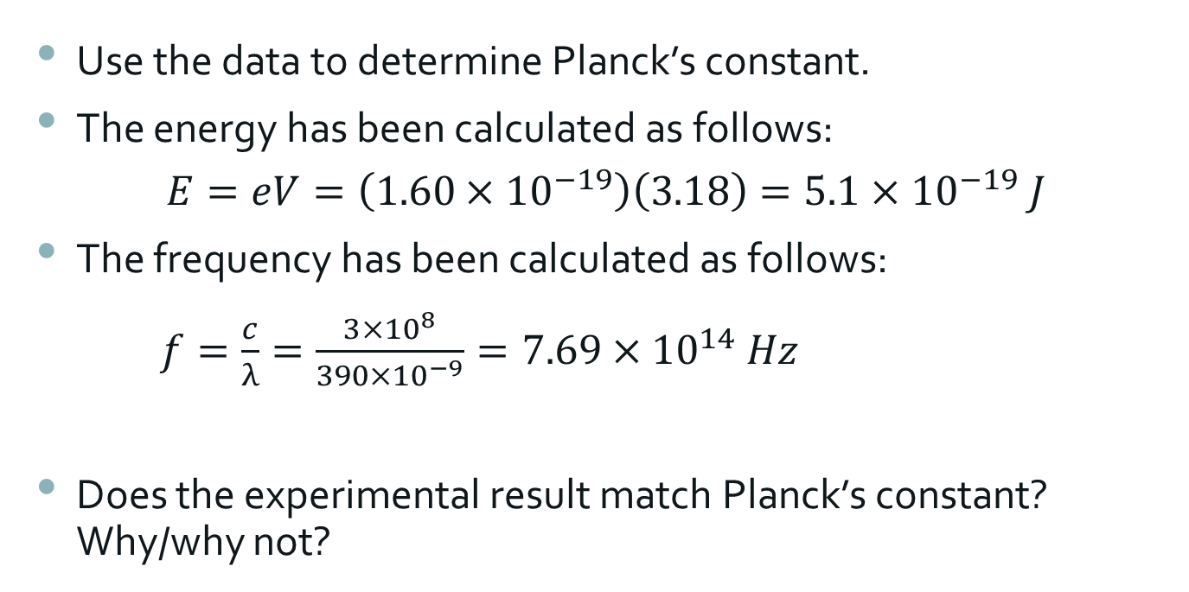
Use the data to determine Planck’s constant.
The energy has been calculated as follows:
$$E=eV=\left(1.60×{10}^{−19}\right)\left(3.18\right)=5.1×{10}^{−19} J$$
The frequency has been calculated as follows:
$f=\frac{c}{λ}=\frac{3×{10}^{8}}{390×{10}^{−9}}=7.69×{10}^{14} Hz$
Does the experimental result match Planck’s constant? Why/why not?
LED Color | Wavelength λ | Voltage V | Energy E = eV | Frequency F = c/λ | Planck’s Constant (h)
UV | 390 nm | 3.18 V | 5.1 X 10⁻¹⁹ J | 7.69 X 10¹⁴ Hz

Slide 27
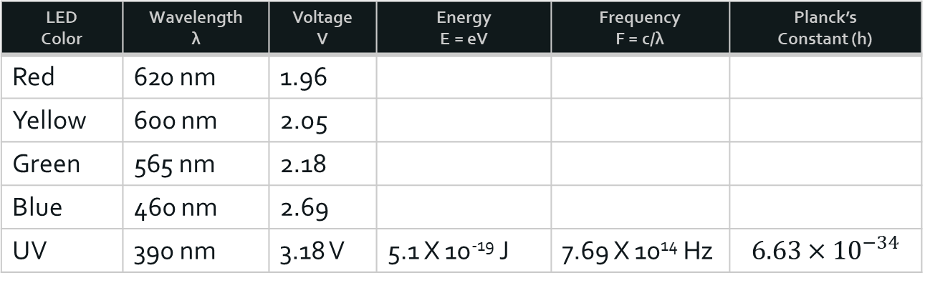
Now complete the following table.
What do you observe? How does this align with your knowledge of experimental data?
LED Color | Wavelength λ | Voltage V | Energy E = eV | Frequency F = c/λ | Planck’s Constant (h)
Red | 620 nm | 1.96
Yellow | 600 nm | 2.05
Green | 565 nm | 2.18
Blue | 460 nm | 2.69
UV | 390 nm | 3.18 V | 5.1 X 10⁻¹⁹ J | 7.69 X 10¹⁴ Hz | $$6.63×{10}^{−34}$$

Slide 28
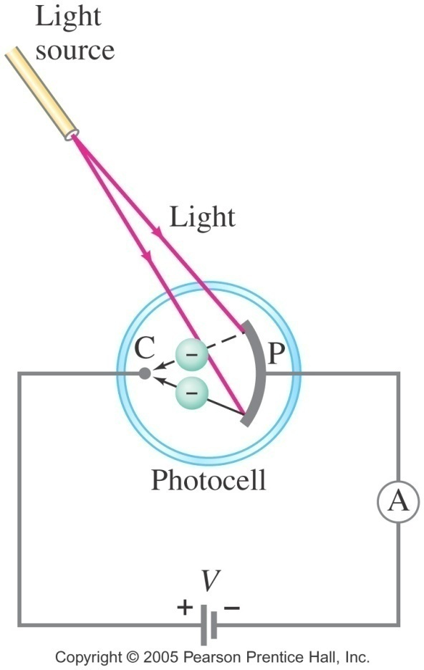
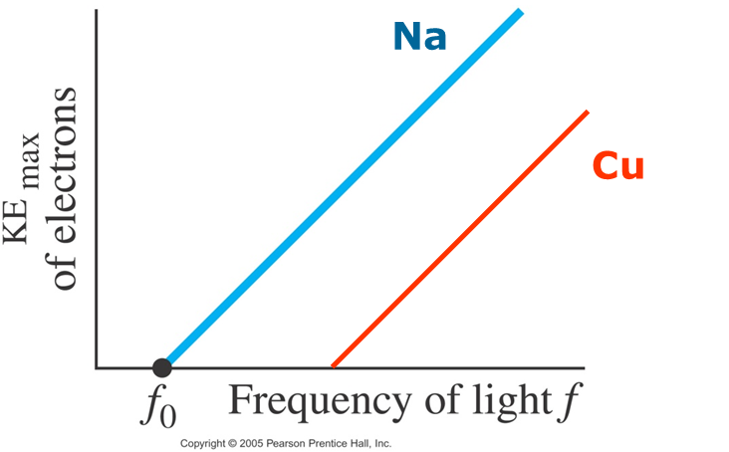
Photoelectric effect
Electrons are ejected when a light strikes a metal surface, provided that the frequency of the light is ≥ the threshold frequency of the metal.
The photocurrent produced is proportional to the intensity of light.
The maximum kinetic energy of photoelectrons is proportional to the frequency of the incident light.
The maximum kinetic energy of photoelectrons is NOT proportional to the intensity of the light.

Slide 29
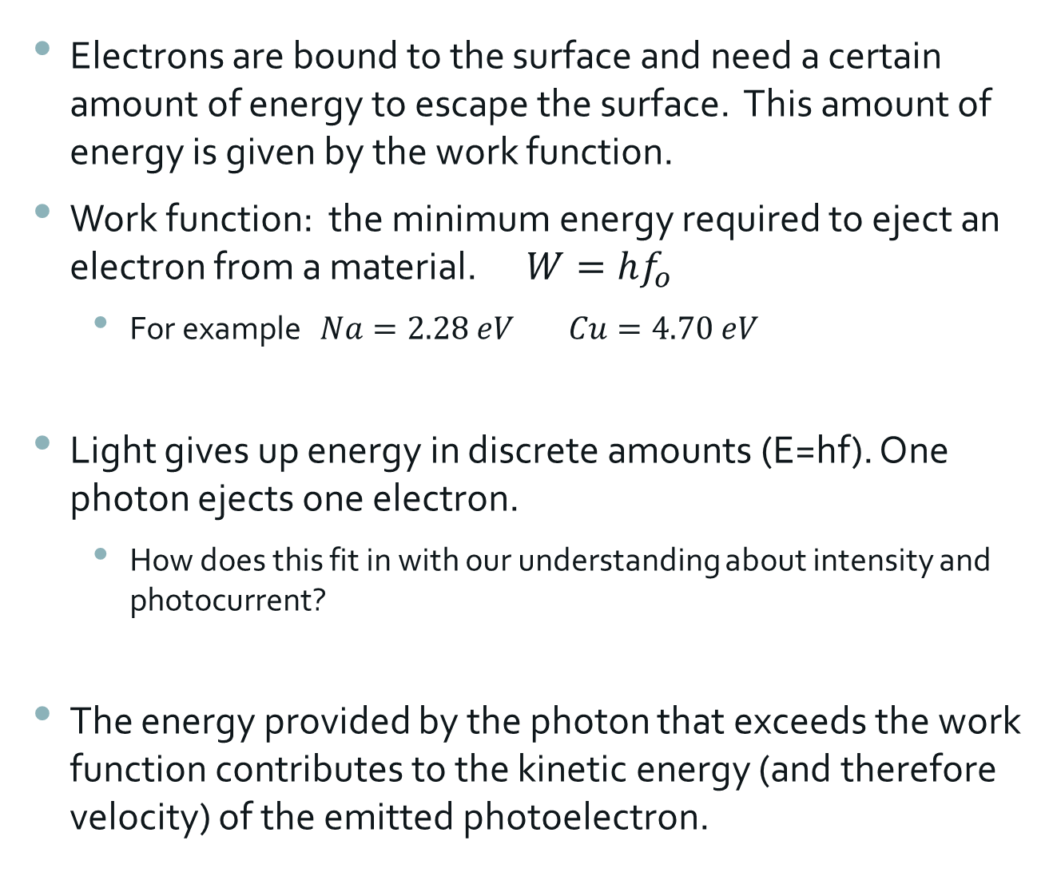
Electrons are bound to the surface and need a certain amount of energy to escape the surface. This amount of energy is given by the work function.
Work function: the minimum energy required to eject an electron from a material. $W=hf_{o}$
  For example $Na=2.28 eV$ $Cu=4.70 eV$
Light gives up energy in discrete amounts (E=hf). One photon ejects one electron.
  How does this fit in with our understanding about intensity and photocurrent?
The energy provided by the photon that exceeds the work function contributes to the kinetic energy (and therefore velocity) of the emitted photoelectron.
Notes:
Conduction band electrons are the least bound of all the electrons, even less bound than outer shell electrons far from the nucleus.
Some electrons are able to take in a small amount of the incoming photon energy and escape at maximum energy.
More tightly bound electrons can also escape, but they will have less than maximum energy when they escape.
Some electrons simply bump into other electrons, causing an increase in temperature but not escaping.
The range of electron energies as they leave the surface is between 0 and KE_{max}

Slide 30


$$Kinetic Energy of photoelectron=Energy supplied by photon −the Energy required to release an electron$$
$$E_{k}=hf−W$$

Slide 31
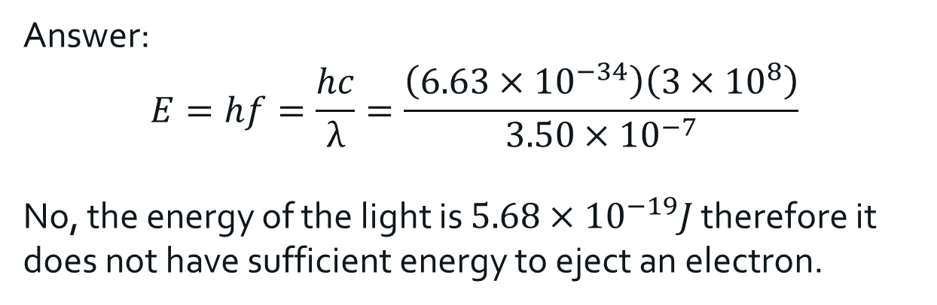
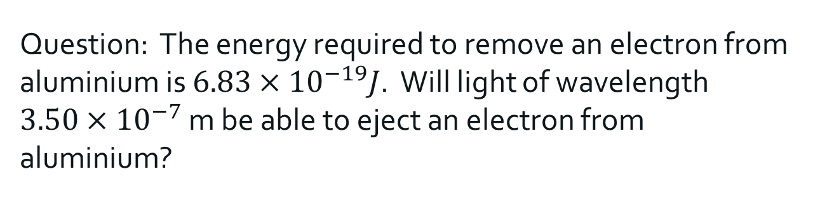
Question: The energy required to remove an electron from aluminium is $6.83×{10}^{−19}J$. Will light of wavelength $3.50×{10}^{−7}$ m be able to eject an electron from aluminium?
Answer:
$$E=hf=\frac{hc}{λ}=\frac{\left(6.63×{10}^{−34}\right)\left(3×{10}^{8}\right)}{3.50×{10}^{−7}}$$
No, the energy of the light is $5.68×{10}^{−19}J$ therefore it does not have sufficient energy to eject an electron.

Slide 32
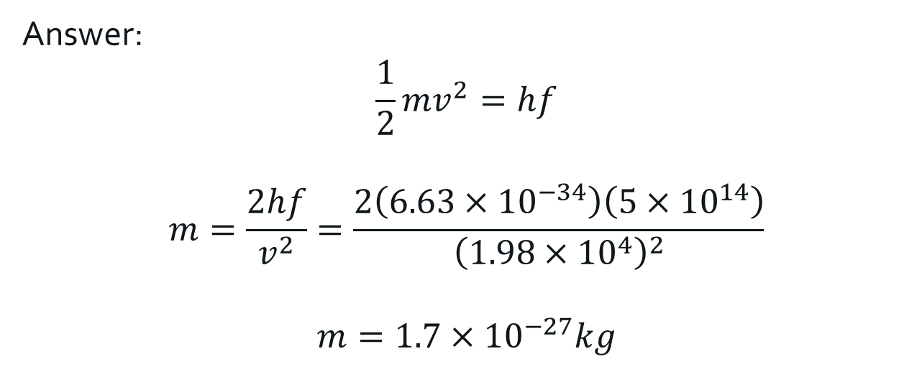
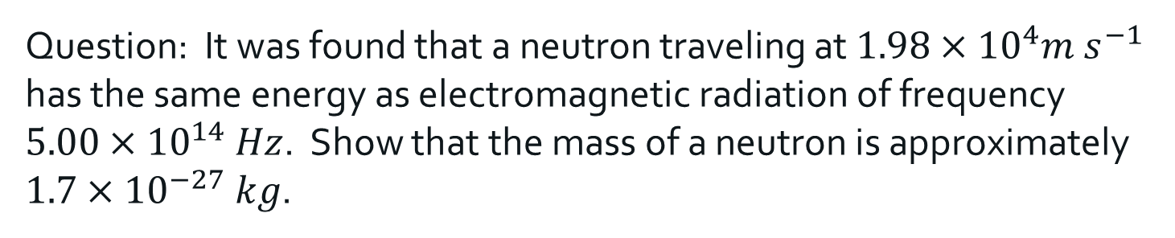
Question: It was found that a neutron traveling at $1.98×{10}^{4}m s^{−1}$ has the same energy as electromagnetic radiation of frequency $5.00×{10}^{14} Hz$. Show that the mass of a neutron is approximately $1.7×{10}^{−27} kg$.
Answer:
$$\frac{1}{2}mv^{2}=hf$$
$$m=\frac{2hf}{v^{2}}=\frac{2\left(6.63×{10}^{−34}\right)\left(5×{10}^{14}\right)}{{\left(1.98×{10}^{4}\right)}^{2}}$$
$$m=1.7×{10}^{−27}kg$$

Slide 33
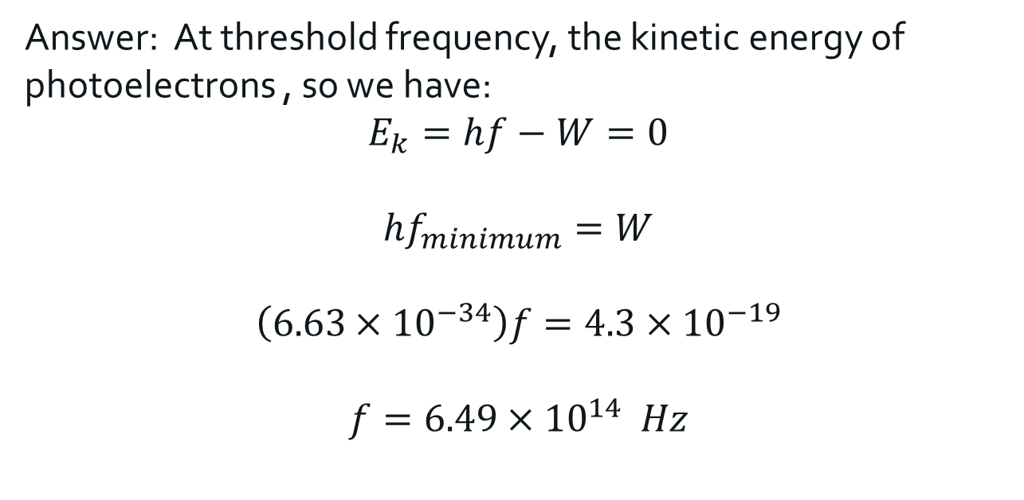
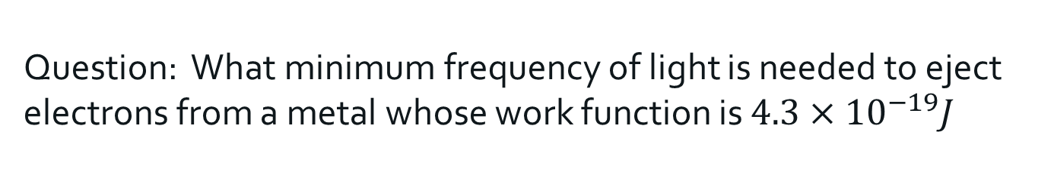
Question: What minimum frequency of light is needed to eject electrons from a metal whose work function is $4.3×{10}^{−19}J$
Answer: At threshold frequency, the kinetic energy of photoelectrons , so we have:
$$E_{k}=hf−W=0$$
$$hf_{minimum}=W$$
$$\left(6.63×{10}^{−34}\right)f=4.3×{10}^{−19}$$
$$f=6.49×{10}^{14} Hz$$

Slide 34

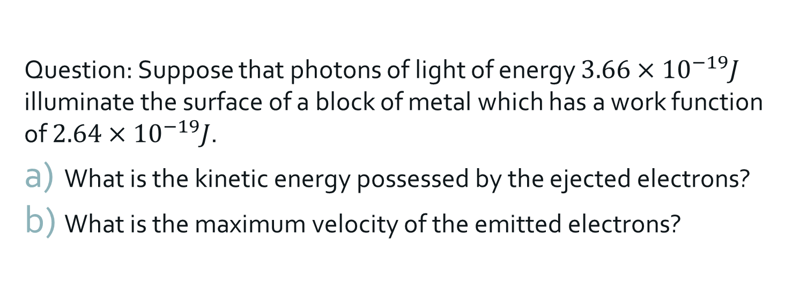
Question: Suppose that photons of light of energy $3.66×{10}^{−19}J$ illuminate the surface of a block of metal which has a work function of $2.64×{10}^{−19}J$.
What is the kinetic energy possessed by the ejected electrons?
What is the maximum velocity of the emitted electrons?
Answer: a) $E_{k}=hf−W$
$$E_{k}=3.66×{10}^{−19}−2.64×{10}^{−19}=1.02×{10}^{−19} J$$
b)
$$\frac{1}{2}(9.11×{10}^{−31})v^{2}=1.02×{10}^{−19}$$
$$v=4.73×{10}^{5} m s^{−1}$$

Slide 35
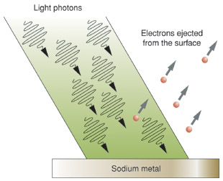
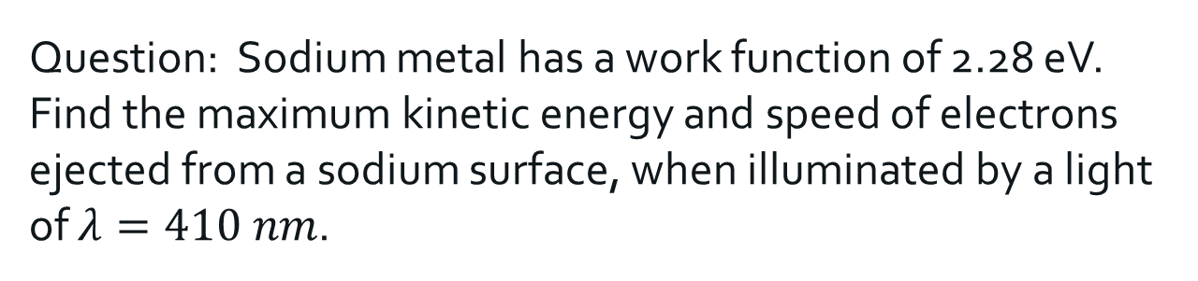
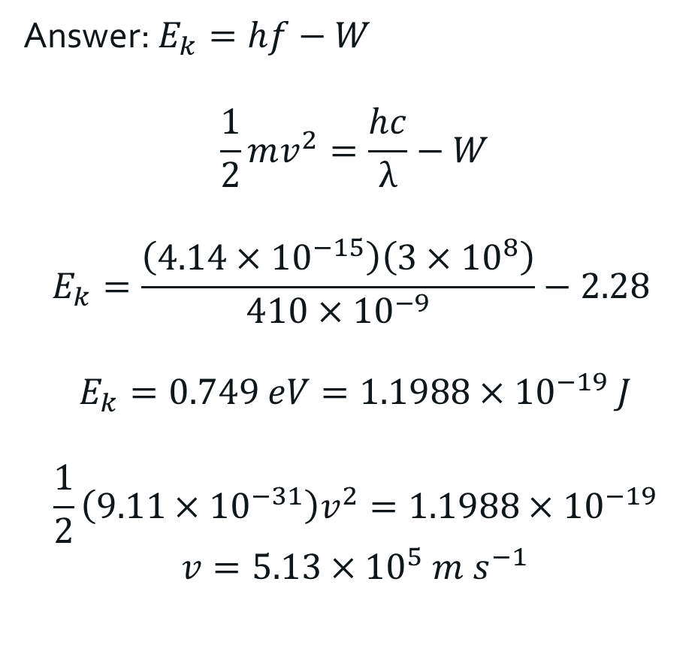
Question: Sodium metal has a work function of 2.28 eV. Find the maximum kinetic energy and speed of electrons ejected from a sodium surface, when illuminated by a light of $λ=410 nm$.
Answer: $E_{k}=hf−W$
$$\frac{1}{2}mv^{2}=\frac{hc}{λ}−W$$
$$E_{k}=\frac{\left(4.14×{10}^{−15}\right)\left(3×{10}^{8}\right)}{410×{10}^{−9}}−2.28$$
$$E_{k}=0.749 eV=1.1988×{10}^{−19} J$$
$$\frac{1}{2}\left(9.11×{10}^{−31}\right)v^{2}=1.1988×{10}^{−19}$$
$$v=5.13×{10}^{5} m s^{−1}$$

Slide 36
